Slide 1


AMERICAN INTERNATIONAL UNIVERSITY-BANGLADESH
COMPUTER AIDED DESIGN AND DRAFTING
GROUP: 15
FACULTY: MODDASSIR KHAN NAYEEM
PRESENTED BY
‣ABU TALHA MOHAMMAD MUYEED (20-44028-2) ‣JAWAD ABDULLAH (20-44133-2)

Slide 2
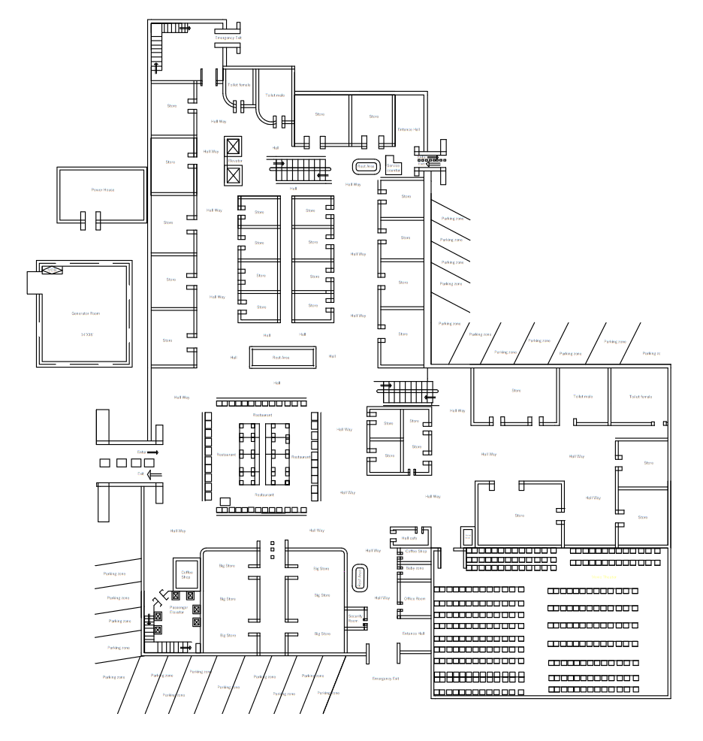
CONDUIT LAYOUT: LAYER-1

Slide 3
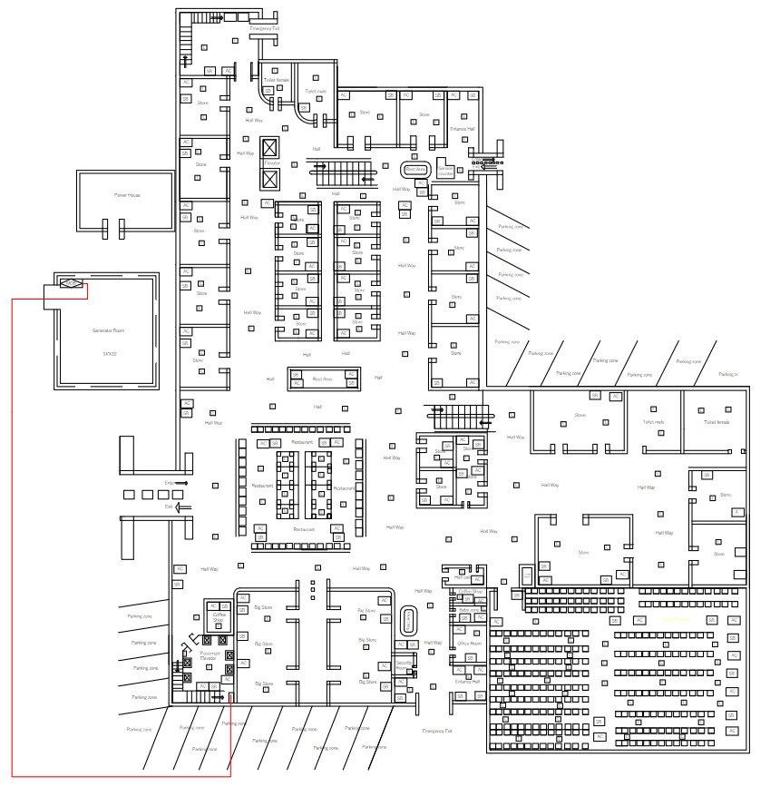
CONDUIT LAYOUT: LAYER-2

Slide 4
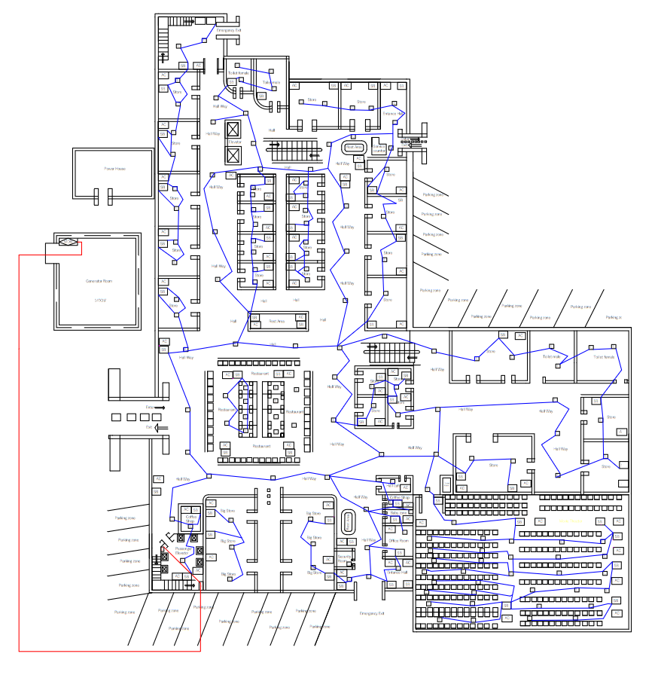
CONDUIT LAYOUT: LAYER-3

Slide 5
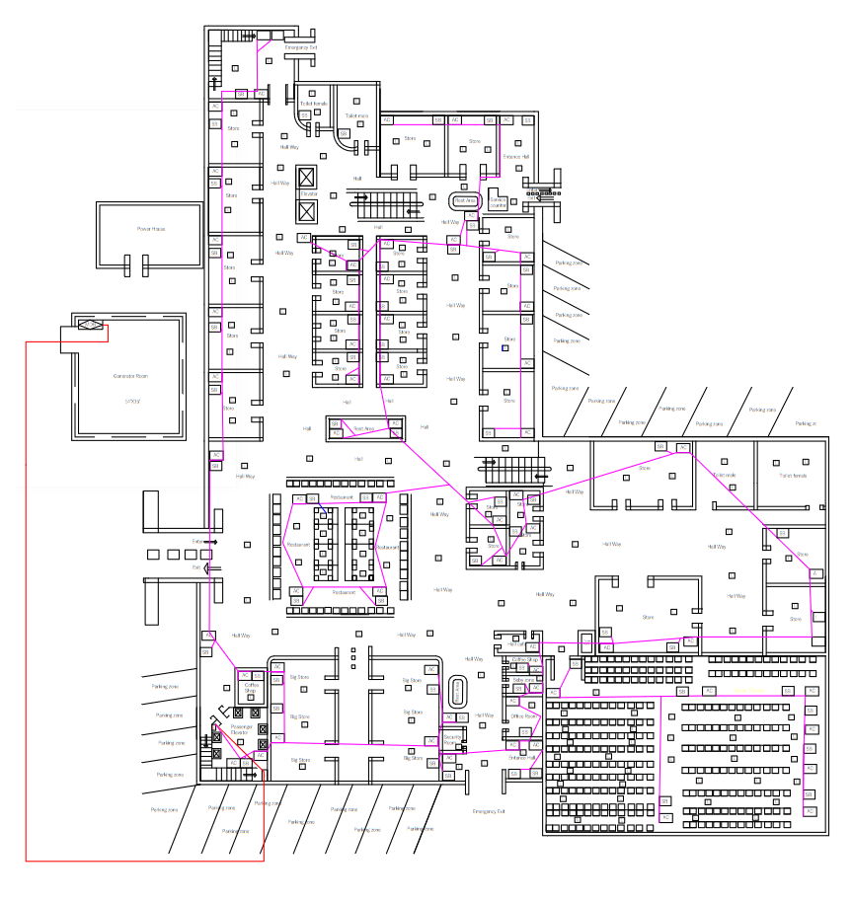
CONDUIT LAYOUT: LAYER-4

Slide 6
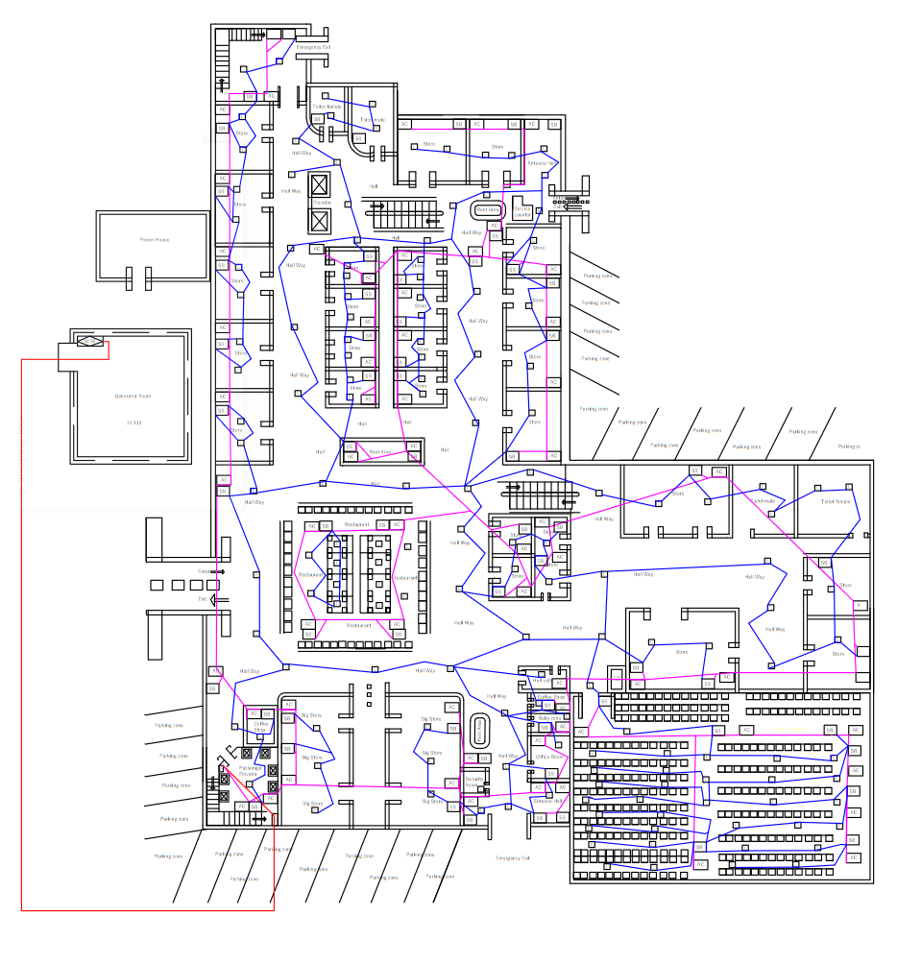
CONDUIT LAYOUT: LAYER-5

Slide 7
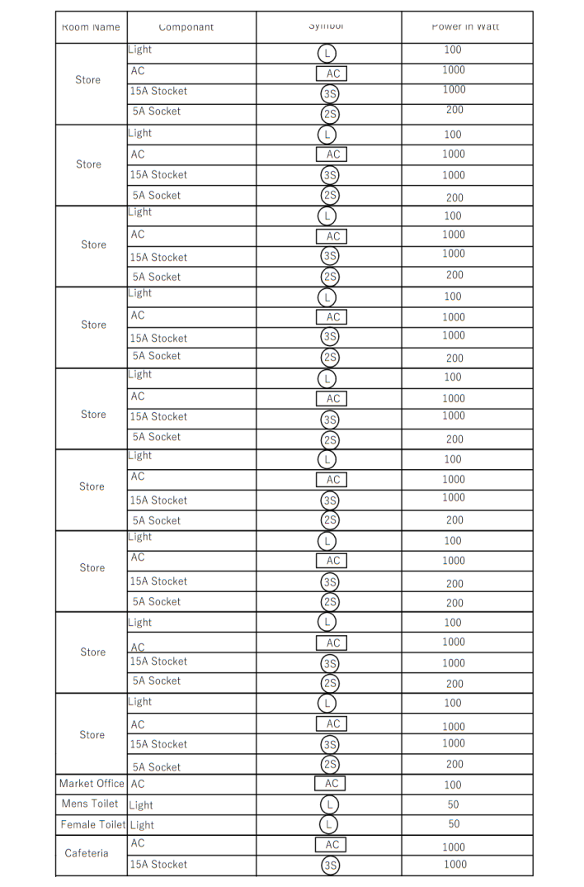
+
CALCULATION OF DISTRIBUTED POWER:

Slide 8
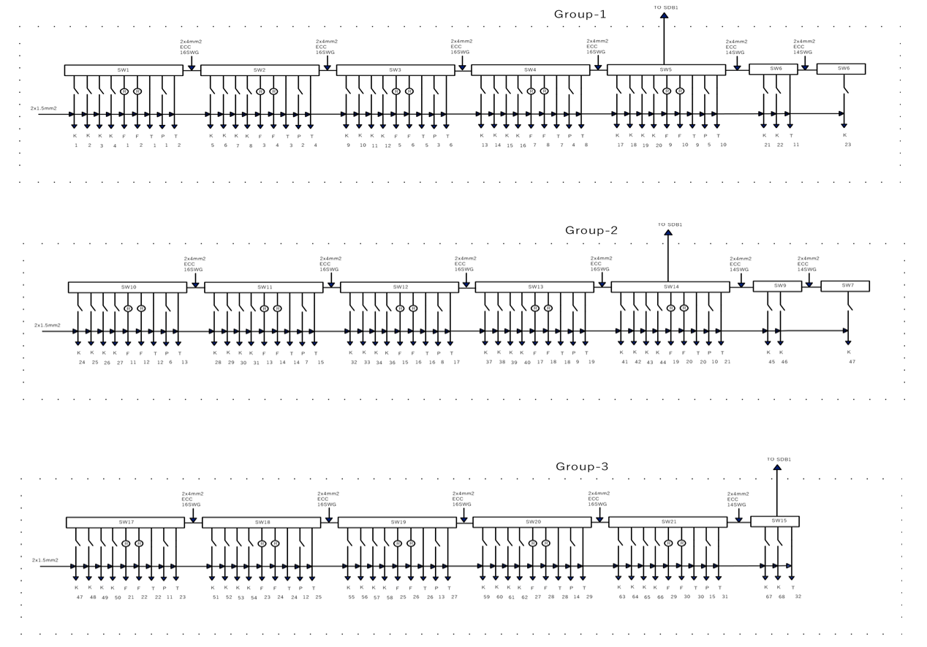
CONNECTION DIAGRAM OF SWITCH BOARD, SUB-DISTRIBUTION BOARD,
AND MAIN DISTRIBUTION BOARD

Slide 9
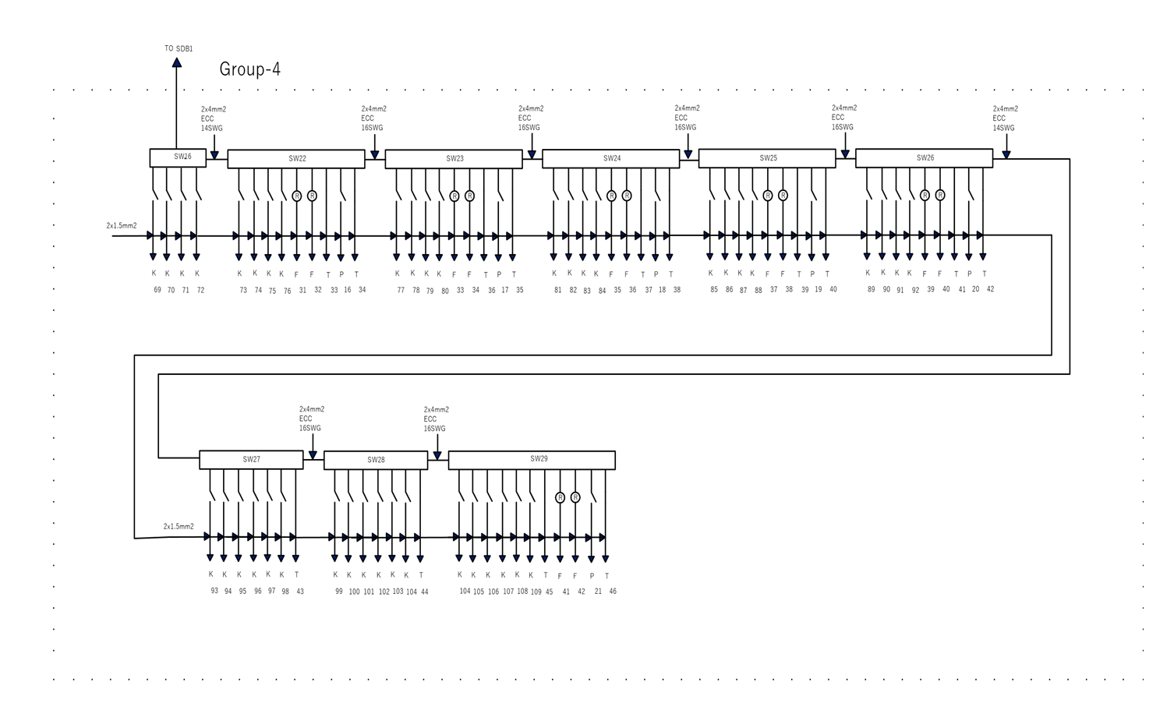

Slide 10
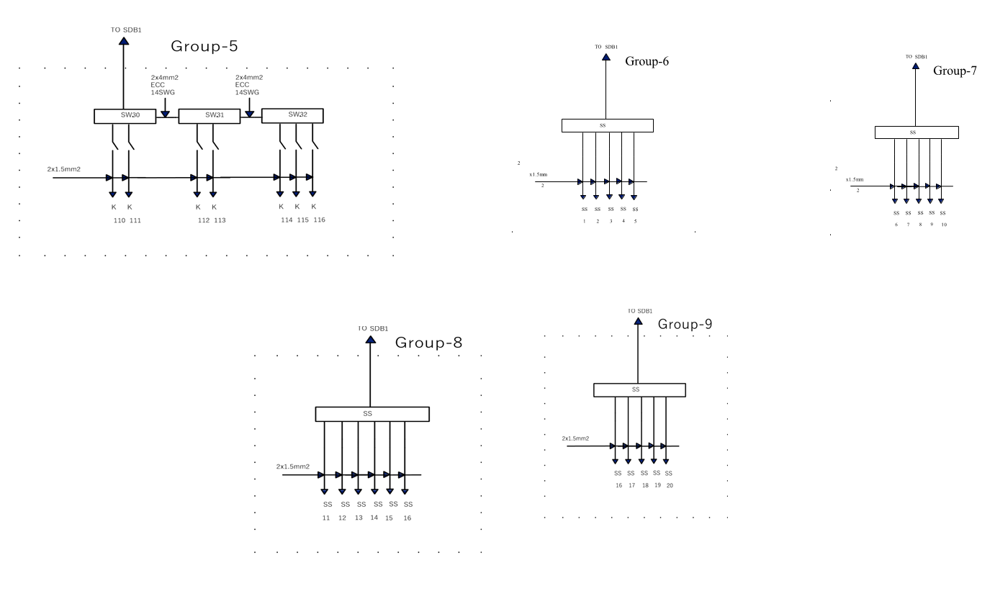

Slide 11
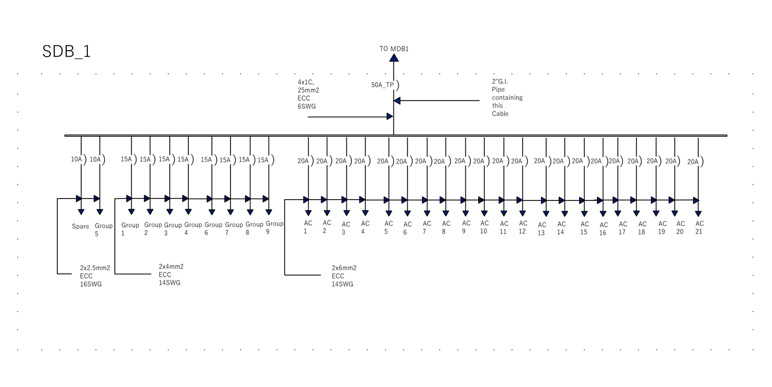

Slide 12
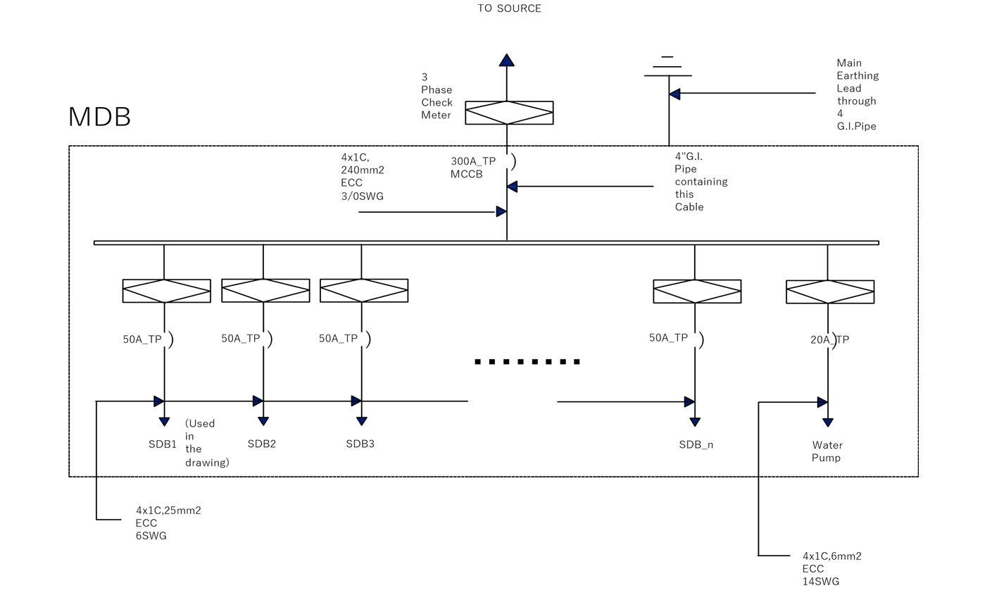

Slide 13
BNBC CODE
•THE BANGLADESH NATIONAL BUILDING CODE (BNBC) IS OVERSEEN BY THE HOUSING AND BUILDING
RESEARCH INSTITUTE (HBRI). THIS CODE ESTABLISHES THE MINIMUM STANDARDS FOR CONSTRUCTION, DESIGN, MATERIAL QUALITY, PROPER USAGE, MAINTENANCE, AND LOCATION OF BUILDINGS.
•THE BANGLADESH NATIONAL BUILDING CODE (BNBC) WAS FIRST PUBLISHED IN 1993 TO REGULATE THE CONSTRUCTION OF BUILDINGS AND MAINTAIN AND UPHOLD THEM TO CERTAIN STANDARDS. THE FIRST VERSION WAS PUBLISHED IN 1993.
•THE BANGLADESH NATIONAL BUILDING CODE (BNBC) IS OVERSEEN BY THE HOUSING AND BUILDING RESEARCH INSTITUTE (HBRI). AND THEY HAVE TAKEN HELP FROM THE (BRTC), (BUET), AND LEADING EXPERTS IN THE FIELD TO REVIEW AND UPDATE THE CODE WHEN NECESSARY.
•THE BNBC IS MEANT TO BE APPLIED BY PROFESSIONALS WORKING WITH CONSTRUCTION PROJECTS, INCLUDING ARCHITECTS, SAFETY INSPECTORS, STRUCTURAL ENGINEERS, INTERIOR DESIGNERS, ENVIRONMENTAL SCIENTISTS, CONTRACTORS, AND LAWYERS.

Slide 14
LOAD CALCULATION
•LOAD FOR ONE 15A SOCKET OUTLET OR 3 PIN = 1000 WATTS NUMBER OF 15A SOCKET OUTLET OR 3 PIN = 19.
•TOTAL LOAD FOR 15A SOCKET OUTLET OR 3 PIN = (19*1000) WATTS = 19,000 WATTS .
•CONSIDER ALL THE LOAD OF ST, SS, TS, TE AS 2 PIN LOAD. LOAD FOR ONE 50A SOCKET OUTLET OR 2 PIN = 100 WATTS NUMBER OF 50A
•SOCKET OUTLET OR 2 PIN = 50.
•CONSIDER ALL THE L, ML, CH & K LIGHTS AS INCANDESCENT LAMPS.
•LOAD FOR ONE LIGHT = 1000 WATTS NUMBER OF LIGHT = 155.
•TOTAL LOAD FOR LIGHT = (155*1000) WATTS = 155,000 WATTS.
•TOTAL LOAD FOR THE FLOOR = (19,000+50+155,000)WATTS
= 174050 WATTS OR 174.05 KW.

Slide 15
THANK YOU

